Slide 1
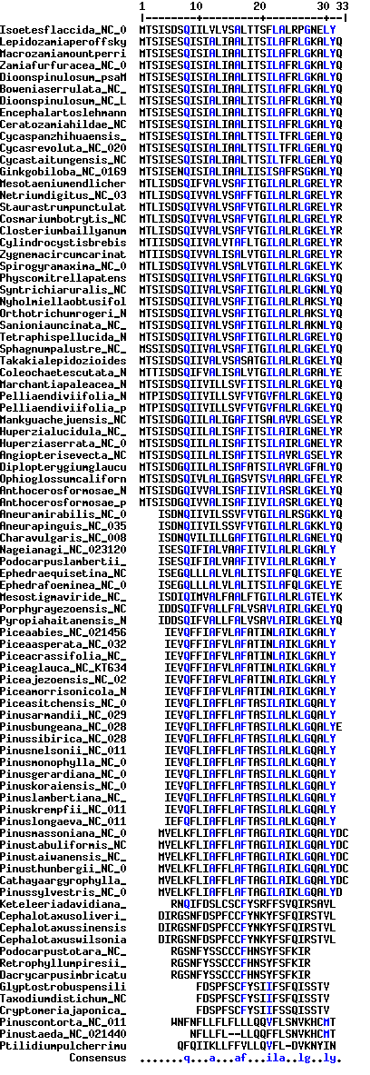
Supplementary Figure 1
Conserved amino acid sequences of PsaM proteins. Blue mark indicate conservation of amino acids below 90%.

Slide 2
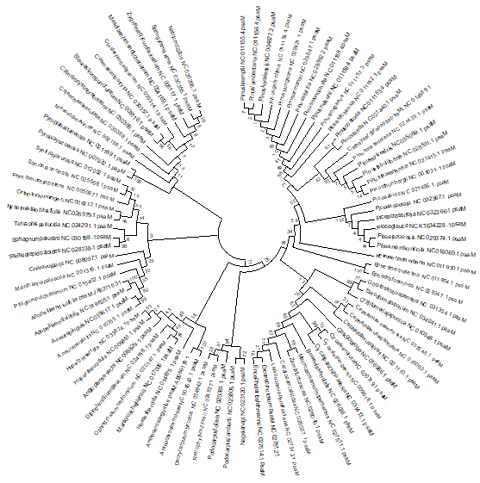
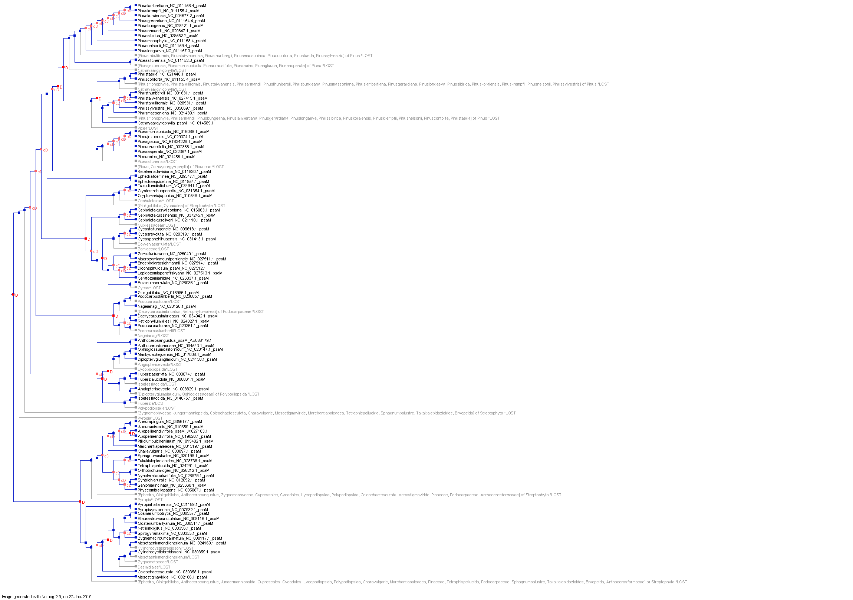
A
B
Supplementary Figure 2. (A) Phylogenetic tree of PsaM genes showing five clusters (mentioned as 1, 2, 3, 4, and 5). (B)
Deletion and duplication event of PsaM genes.
-Duplications: 12
- Co-Divergences: 37
- Transfers: 0
- Losses: 34
- Number of Temporally Feasible Optimal Solutions: 1
Tree Without Losses
- Total nodes: 171
- Internal nodes: 85
- Leaf nodes: 86
- Polytomies: 0
- Size of largest polytomy: 0
- Height: 18
Tree With Losses
- Total nodes: 239
- Internal nodes: 119
- Leaf nodes: 120
- Size of largest polytomy: 0
Height: 22
5
4
1
3
2

Slide 3
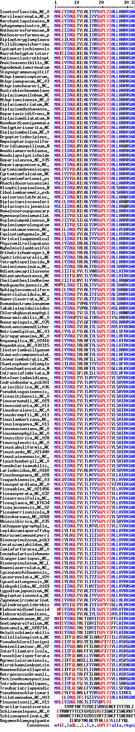
Supplementary Figure 3
Conserved amino acid sequences of Psb30 proteins. Red mark indicate conservation of amino acids of 90% or more.

Slide 4
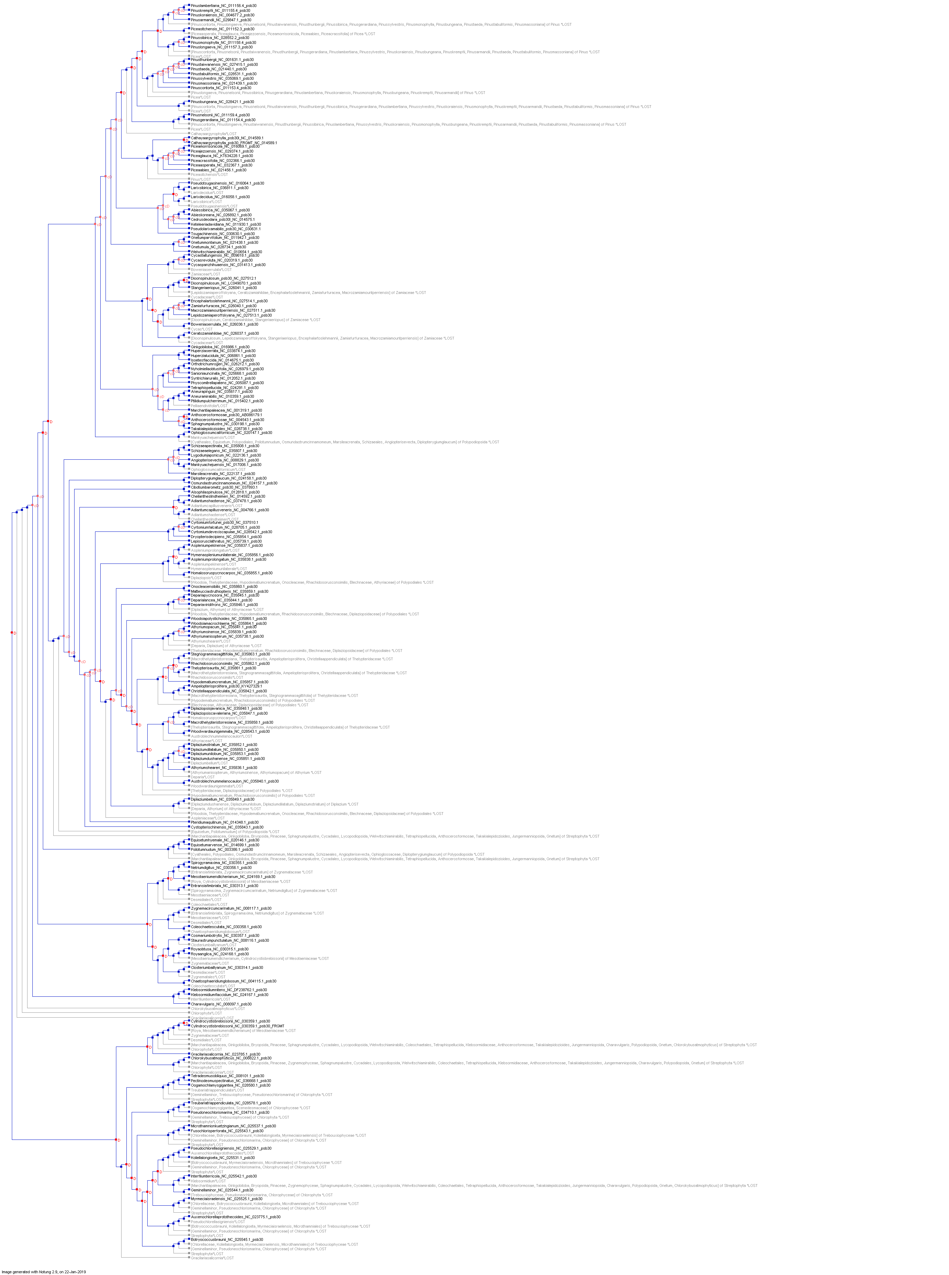
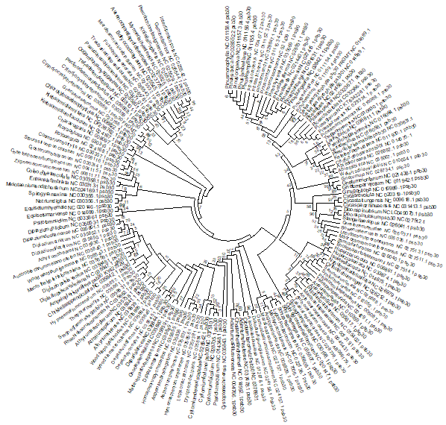
A
B
Supplementary Figure 4. (A) Phylogenetic tree of Psb30 genes.
(B) Deletion and duplication event of Psb30 genes.
- Duplications: 39
- Co-Divergences: 49
- Transfers: 0
- Losses: 120
- Number of Temporally Feasible Optimal Solutions: 1
Tree Without Losses
- Total nodes: 313
- Internal nodes: 156
- Leaf nodes: 157
- Polytomies: 0
- Size of largest polytomy: 0
- Height: 24
Tree With Losses
- Total nodes: 553
- Internal nodes: 276
- Leaf nodes: 277
- Size of largest polytomy: 0
- Height: 34

Slide 5
Supplementary Figure 5
Conserved amino acid sequences of ChlB proteins. Red mark indicate conservation of 90% or more.

Slide 6
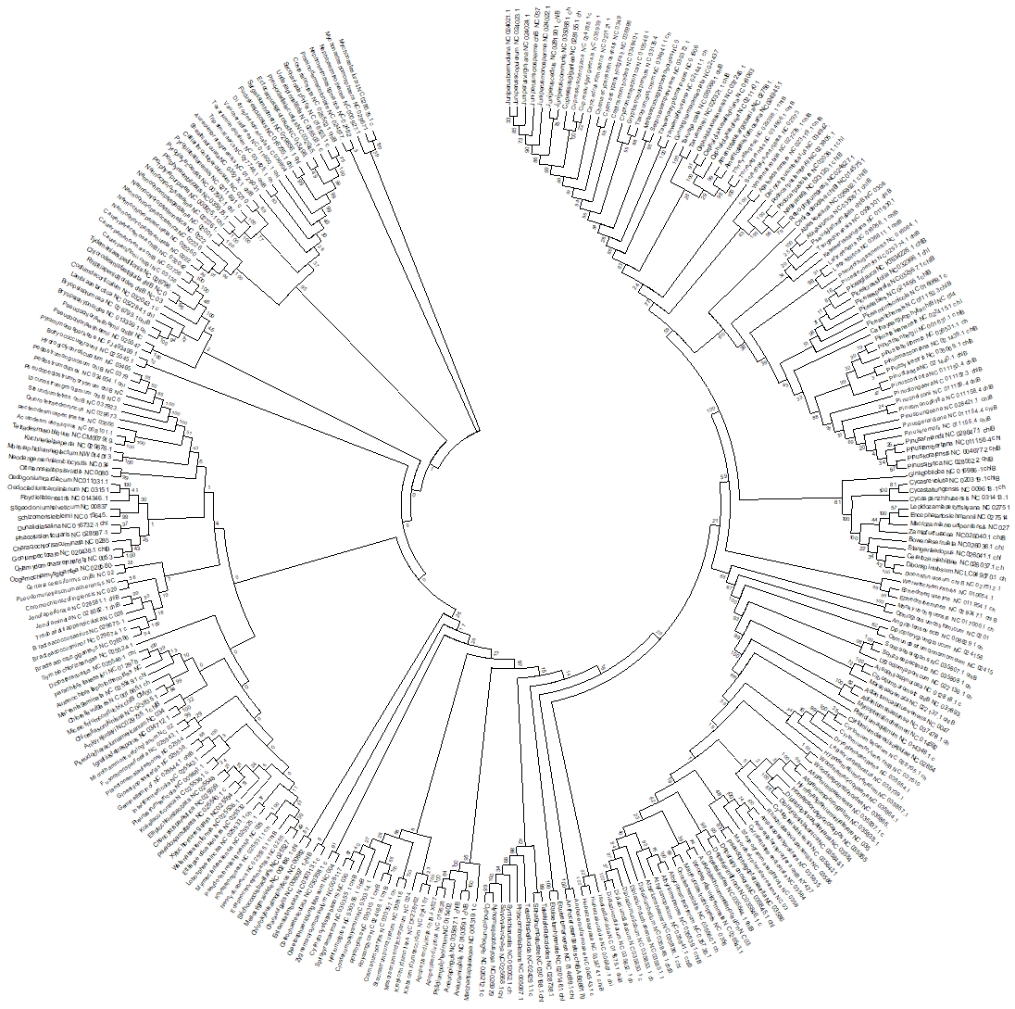
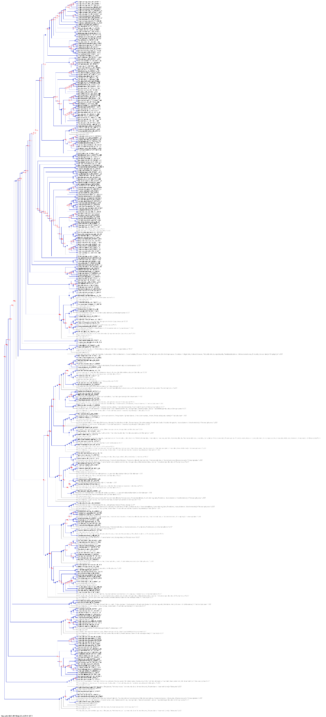
A
B
Supplementary Figure 6. (A) Phylogenetic tree of ChlB genes. (B) Deletion and duplication event of ChlB genes.
- Duplications: 35
- Co-Divergences: 116
- Transfers: 0
- Losses: 126
- Number of Temporally Feasible Optimal Solutions: 1
Tree Without Losses
- Total nodes: 575
- Internal nodes: 287
- Leaf nodes: 288
- Polytomies: 0
- Size of largest polytomy: 0
- Height: 34
Tree With Losses
- Total nodes: 827
- Internal nodes: 413
- Leaf nodes: 414
- Size of largest polytomy: 0
- Height: 37

Slide 7
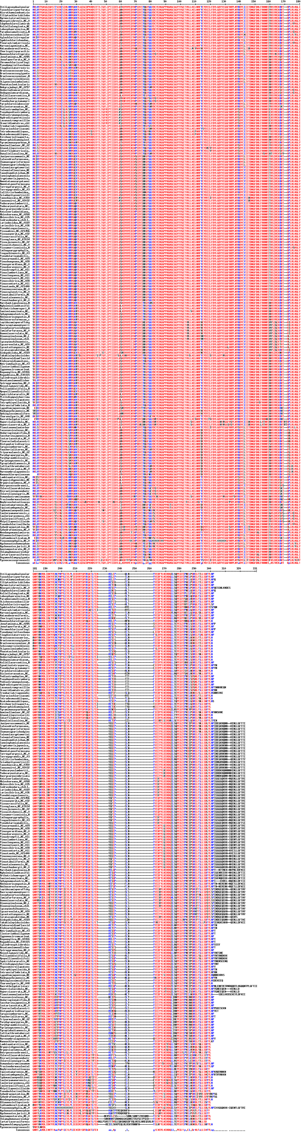
Supplementary Figure 7
Conserved amino acid sequences of ChlL proteins. Red mark indicate conservation of 90% or more.

Slide 8
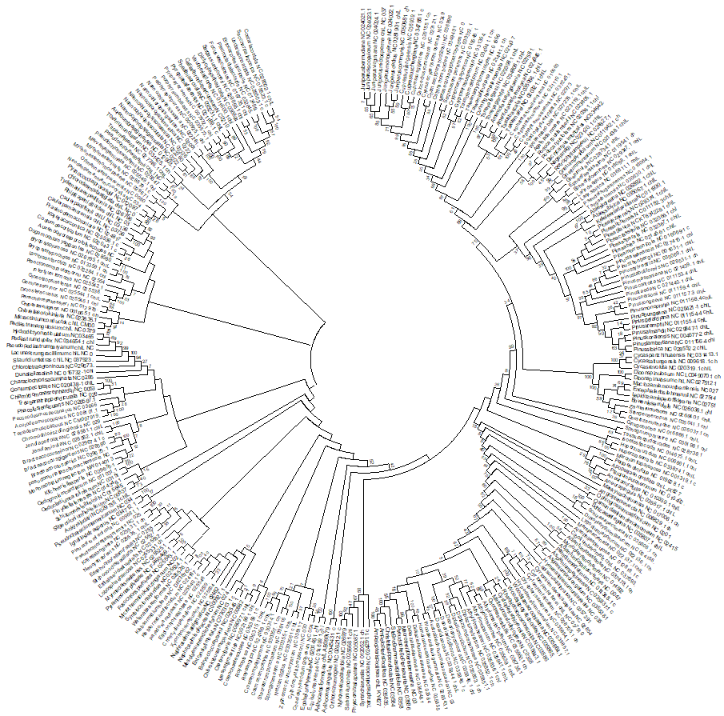
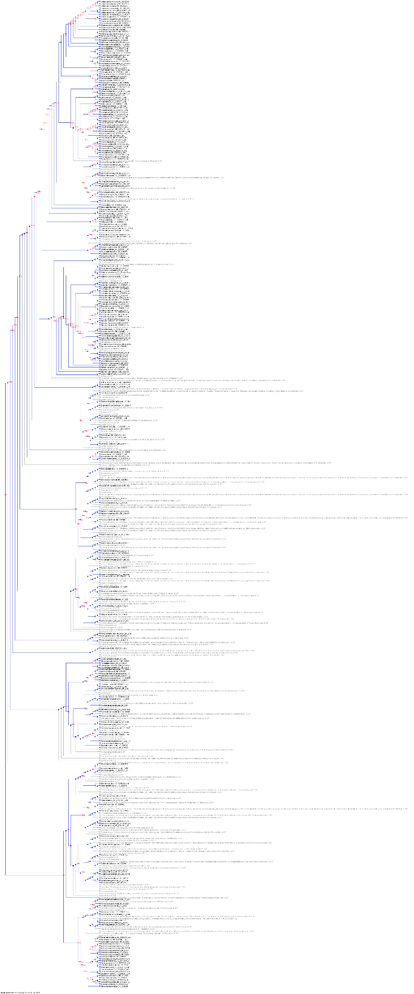
A
B
Supplementary Figure 8. (A) Phylogenetic tree of ChlL genes. (B) Deletion and duplication event of ChlL genes.
- Duplications: 49
- Co-Divergences: 100
- Transfers: 0
- Losses: 184
- Number of Temporally Feasible Optimal Solutions: 1
Tree Without Losses
- Total nodes: 565
- Internal nodes: 282
- Leaf nodes: 283
- Polytomies: 0
- Size of largest polytomy: 0
- Height: 35
Tree With Losses
- Total nodes: 933
- Internal nodes: 466
- Leaf nodes: 467
- Size of largest polytomy: 0
- Height: 39

Slide 9
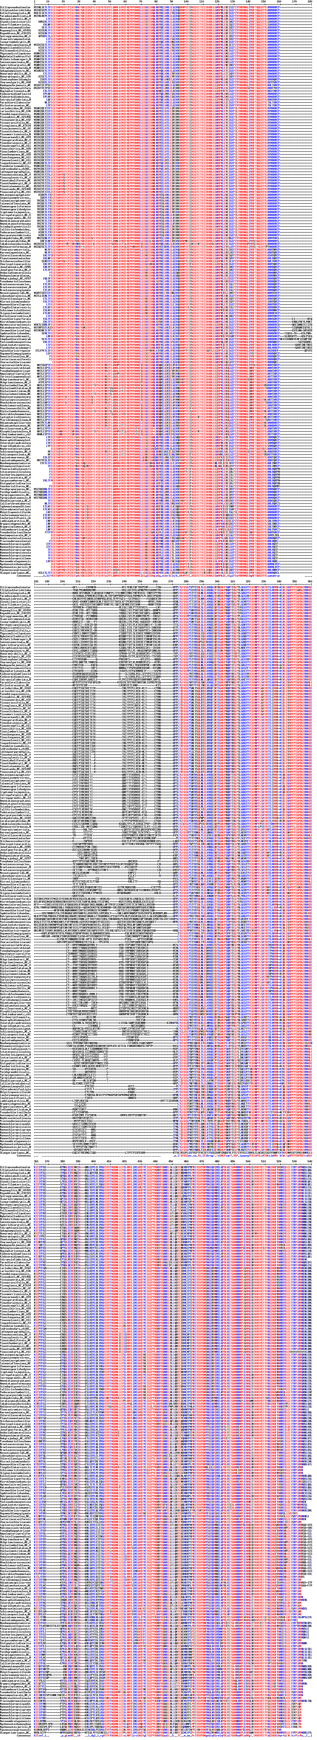
Supplementary Figure 9
Conserved amino acid sequences of ChlN proteins. Red mark indicate conservation of 90% or more.

Slide 10
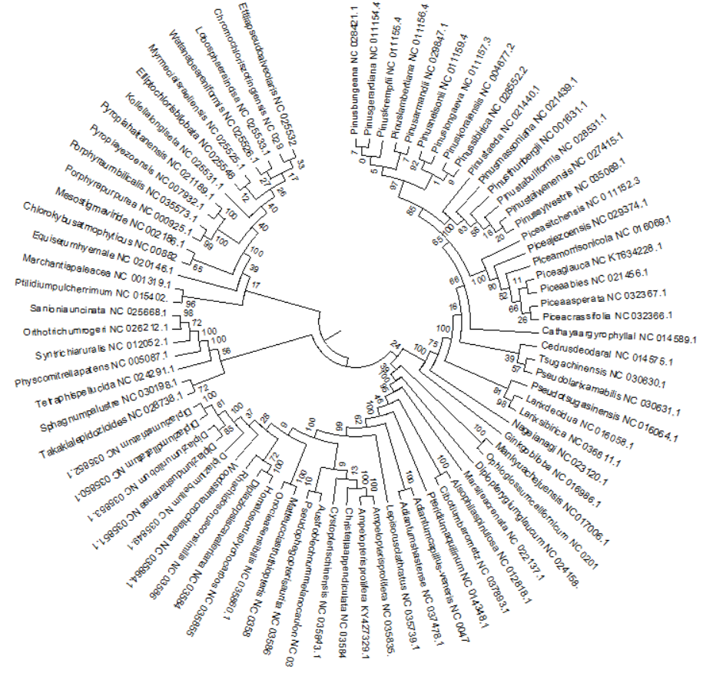
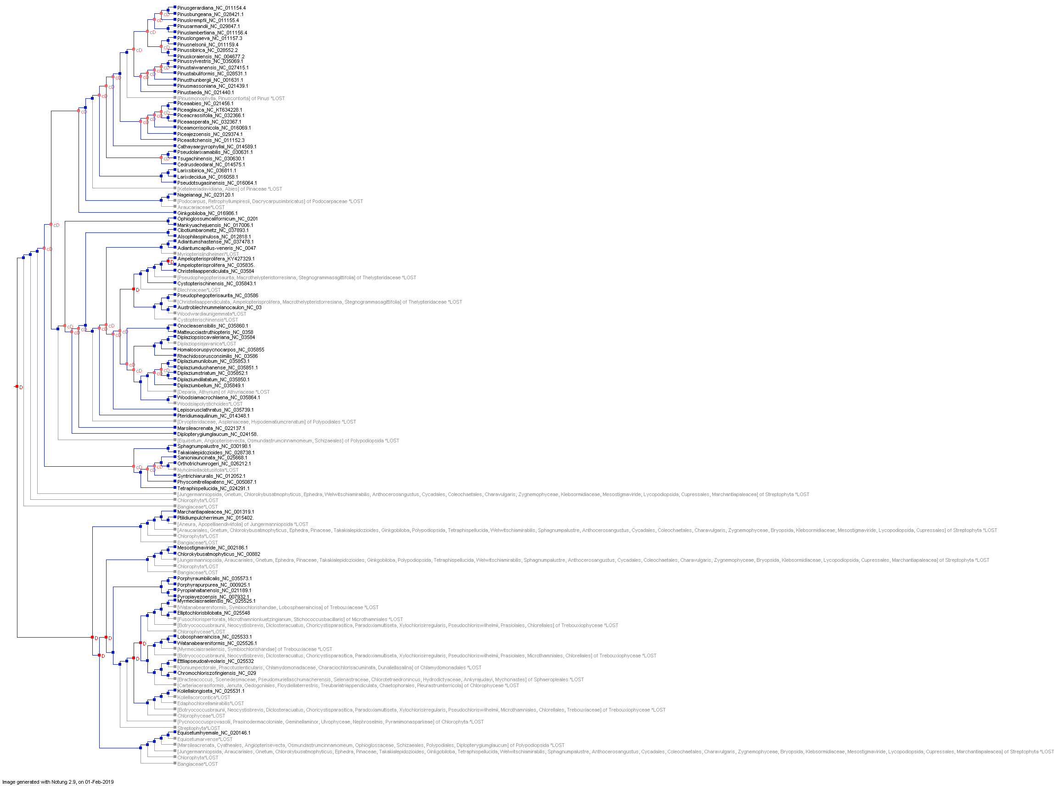
A
B
Supplementary Figure 10. (A) Phylogenetic tree of ChlN genes.
(B) Deletion and duplication event of ChlN genes.
- Duplications: 8
- Co-Divergences: 34
- Transfers: 0
- Losses: 46
- Number of Temporally Feasible Optimal Solutions: 1
Tree Without Losses
- Total nodes: 161
- Internal nodes: 80
- Leaf nodes: 81
- Polytomies: 0
- Size of largest polytomy: 0
- Height: 17
Tree With Losses
- Total nodes: 253
- Internal nodes: 126
- Leaf nodes: 127
- Size of largest polytomy: 0
- Height: 23

Slide 11
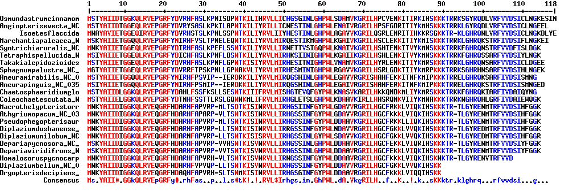
Supplementary Figure 11
Conserved amino acid sequences of Rpl21 proteins. Red mark indicate conservation of 90% or more.

Slide 12
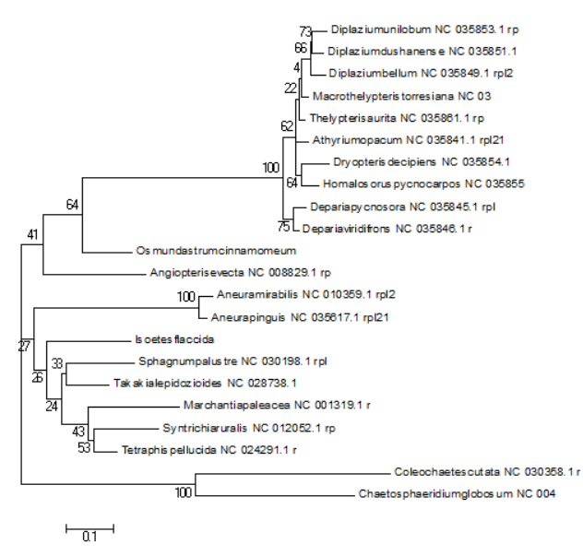
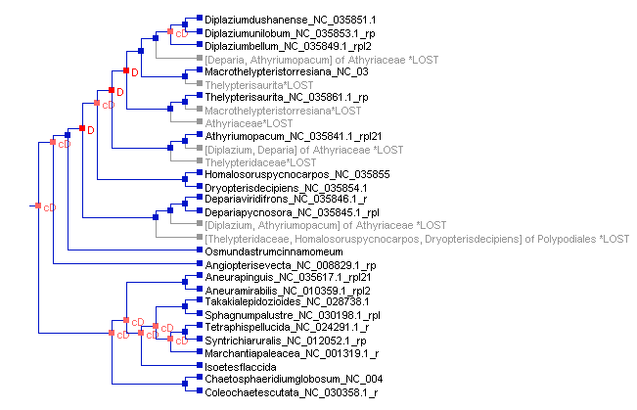
A
B
Supplementary Figure 12. (A) Phylogenetic tree of Rpl21 genes. (B) Deletion and duplication event of Rpl21 genes.
- Duplications: 3
- Co-Divergences: 9
- Transfers: 0
- Losses: 8
- Number of Temporally Feasible Optimal Solutions: 1
Tree Without Losses
- Total nodes: 43
- Internal nodes: 21
- Leaf nodes: 22
- Polytomies: 0
- Size of largest polytomy: 0
- Height: 10
Tree With Losses
- Total nodes: 59
- Internal nodes: 29
- Leaf nodes: 30
- Size of largest polytomy: 0
- Height: 11

Slide 13
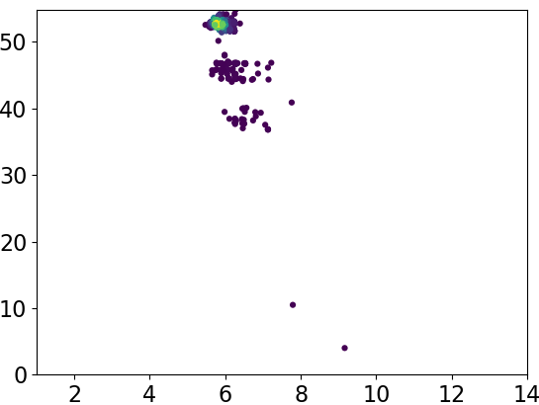
Molecular weight (kDa)
Isoelectric point (pI)
Supplementary Figure 13. Molecular weight and isoelectric point (pI) of RBCL proteins.

Slide 14
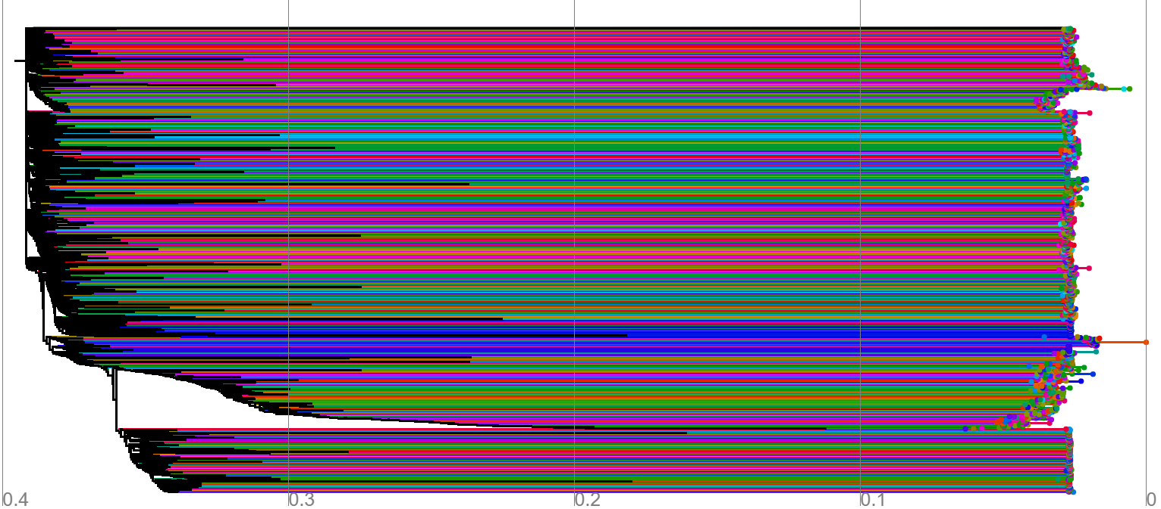
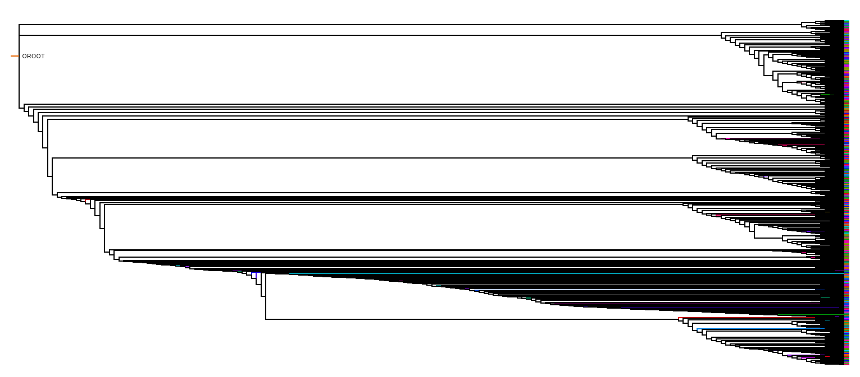
A
B
Supplementary Figure 14
Recombination events of chloroplast genomes (A) unresolved (B) resolved. Chloroplast genomes were found to undergo vivid genomic recombination; which might be one of the possible reasons regarding the loss of the IR region in the chloroplast genomes. The color represents their link of recombination event in different taxon/groups. The genomic recombination of chloroplast genomes was studied using the IcyTree viewer (https://icytree.org/) server.

Slide 15
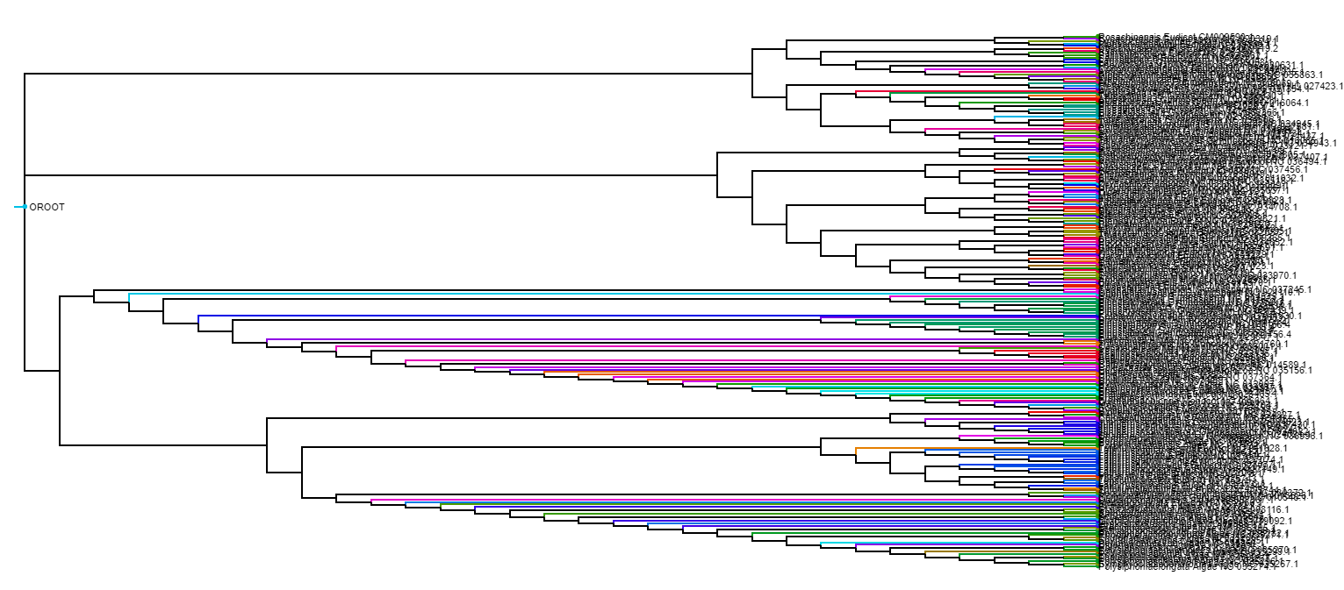
Supplementary Figure 15
Recombination event of inverted repeat deleted chloroplast genomes. Each color indicates a locus and their distribution in different cluster indicates they have been undergone vivid recombination.

Slide 16
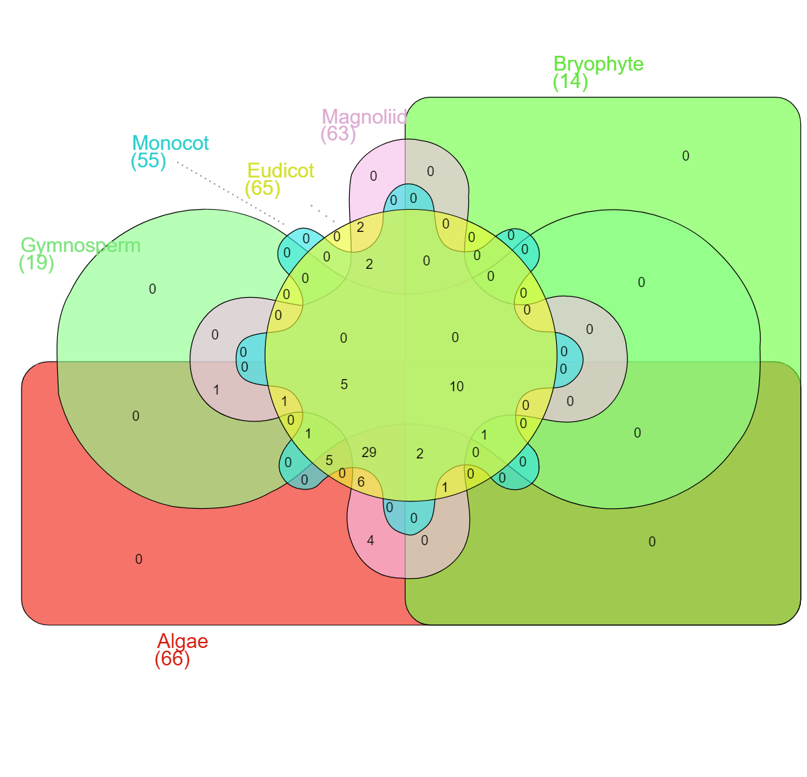
Supplementary Figure 16. Venn diagram showing group specific loss of chloroplast encoding genes in algae, gymnosperm, bryophyte, monocot, eudicot, and magnoliid.

Slide 17
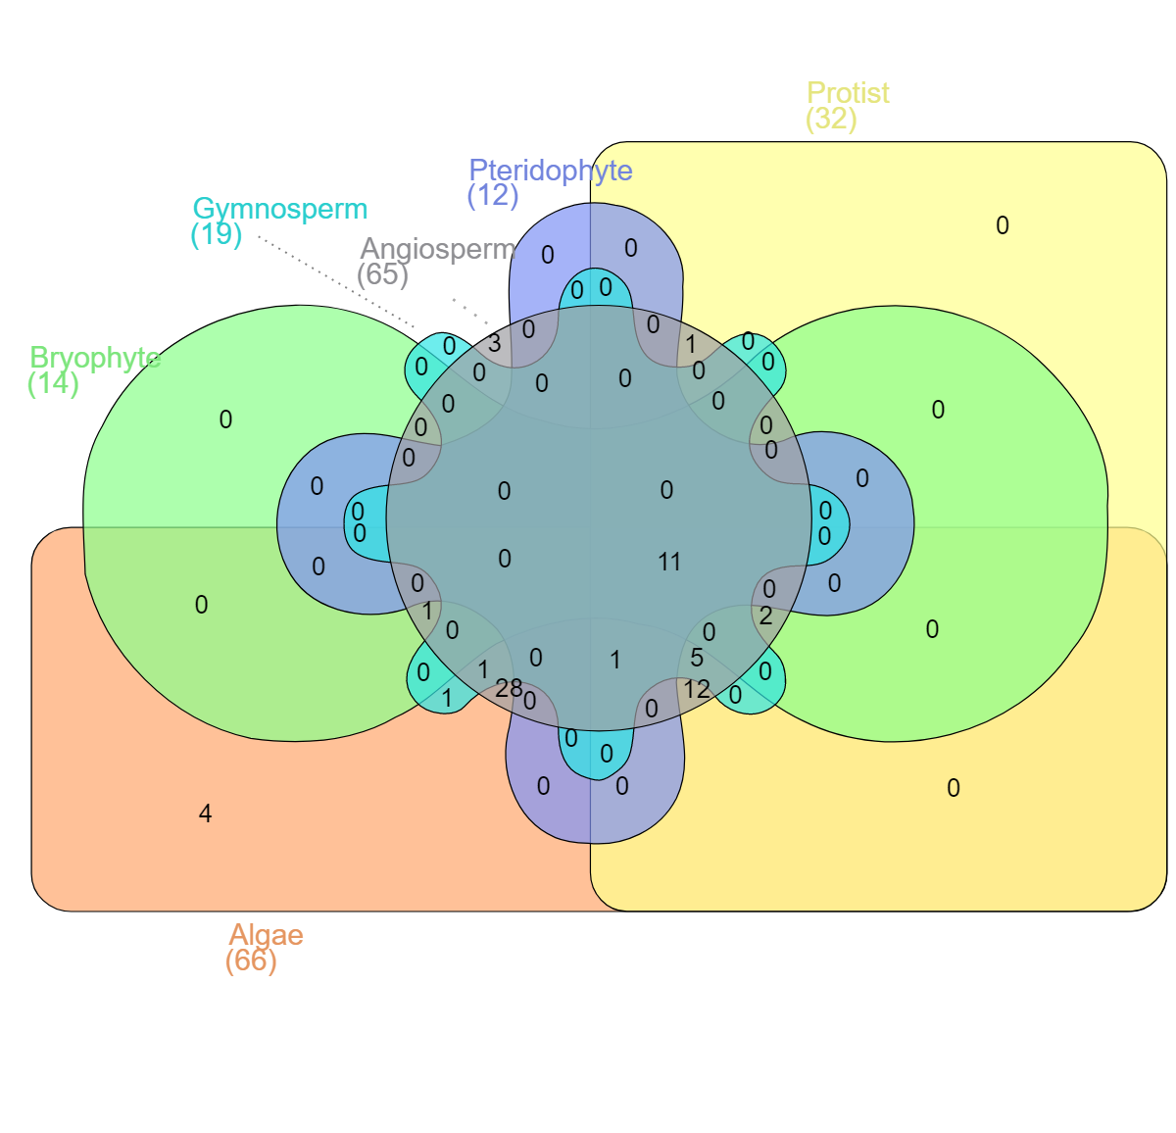
Supplementary Figure 17. Venn diagram showing group specific loss of chloroplast encoding genes in algae, bryophyte, gymnosperm, angiosperm, pteridophyte and protist.

Slide 18
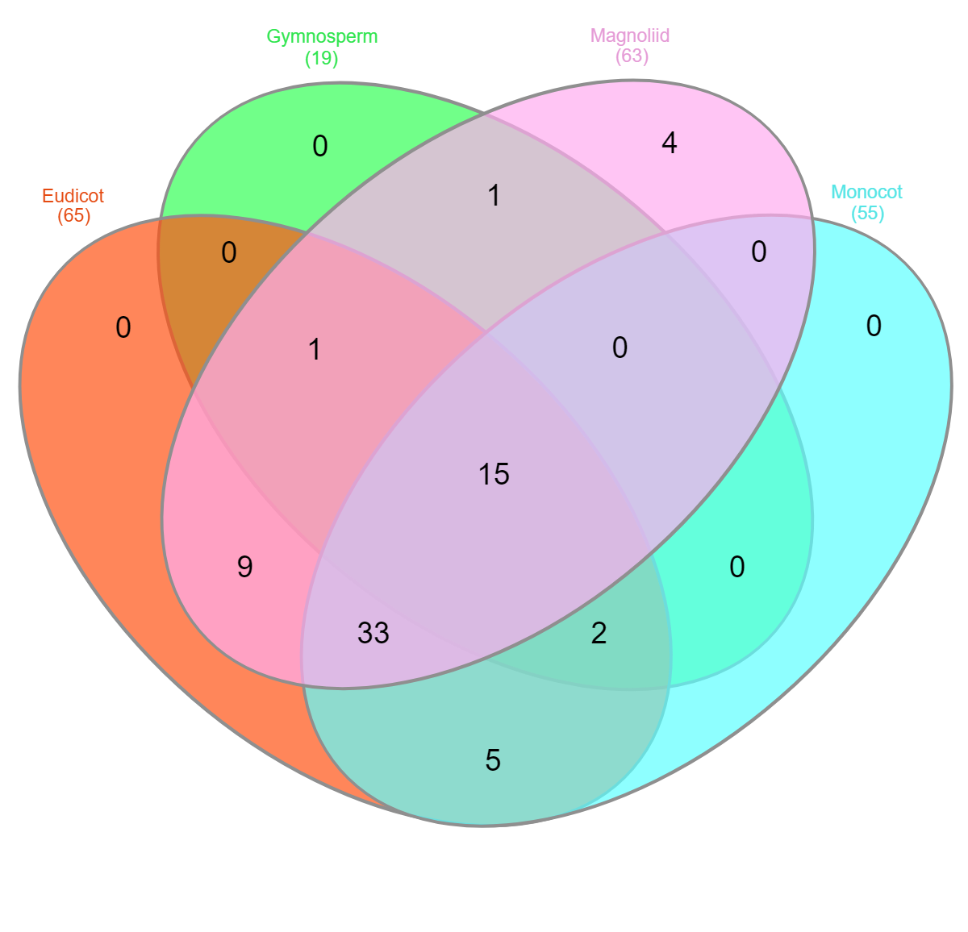
Supplementary Figure 18. Venn diagram showing group specific loss of chloroplast encoding genes in eudicot, gymnosperm, monocot, and magnoliid.

